Slide 1
OSCE 7/18
NDH A&E

Slide 2
Case 1
M/62, c/o: severe retrosternal chest pain for 30 minutes, radiation to jaw, associated with sweating
BP 135/98 p100, afebrile, SaO2 100% 6L O2
ECG done

Slide 3
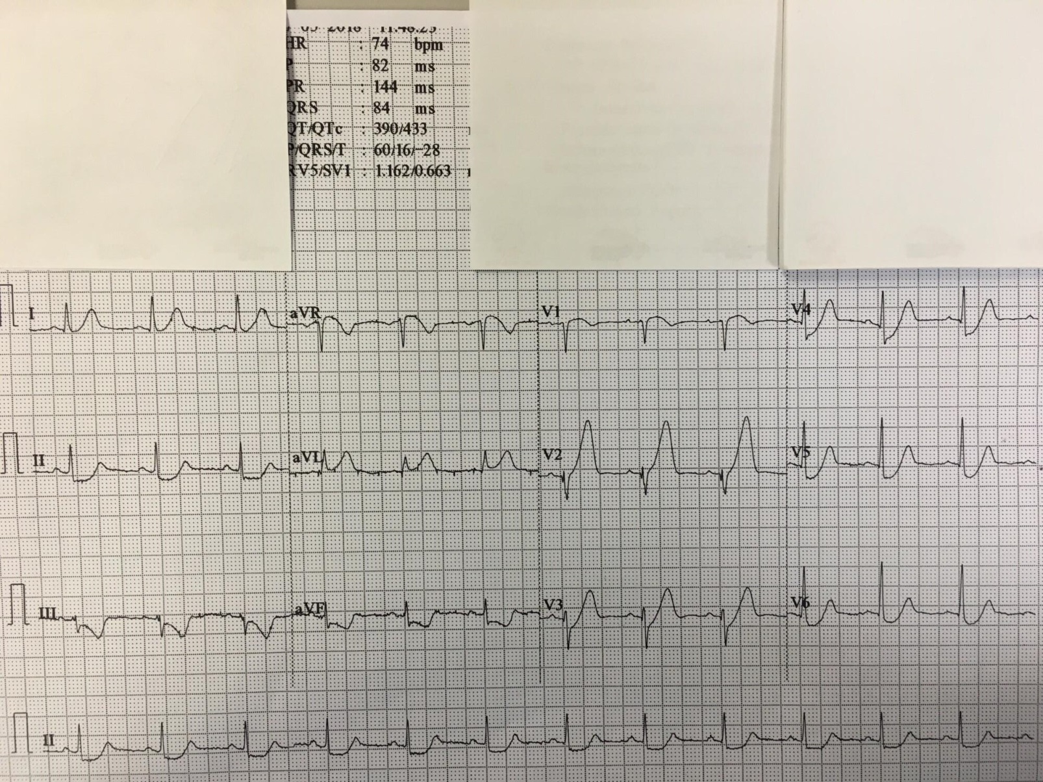
ECG

Slide 4
Questions - 1
What are the ECG abnormalities?
STE in leads aVR/V1, upsloping STD in precordial leads, STD in inferior leads

Slide 5
Questions - 2
What is your diagnosis?
De winter syndrome

Slide 6
Questions – 3
What is the likely culprit vessel?
LAD

Slide 7
Questions - 4
How would you manage the patient in A&E?
MONA, consult CCU (thrombolytic or PCI)

Slide 8
Questions - 5
What is the definite treatment?
Primary PCI

Slide 9
De Winter ECG
An anterior STEMI equivalent the presents without obvious STE
Features: ST depression and peaked T waves in precordial leads
Seen in ~ 2% of acute stenosis of LAD → immediate need of PCI

Slide 10
Diagnostic criteria
Tall, prominent, symmetric T waves in the precordial leads
Upsloping ST segment depression >1mm at the J point in the precordial leads → features differentiate from hyper-acute T waves
Absence of STE in precordial leads
STE (0.5-1mm) in aVR
“Normal” STEMI morphology may precede or follow the de Winter pattern

Slide 11
Case 2
M/59, GPH, dizziness/Rt face/limbs weakness since 06:30, arrive A&E 09:33
Exam: GCS 15/15, BP 152/76 p59, Rt side power 0/5, Lt side power full, multi-directional nystagmus, dysphasia with slurred speech

Slide 12
Questions
What is your diagnosis?
Posterior circulation stroke

Slide 13
Answers
What is your immediate management?
Set IV line, baseline ECG/blood test (CBC, L/RFT, clotting), attach monitoring (BP/P, cardiac monitor), CT brain, consult stroke team

Slide 14
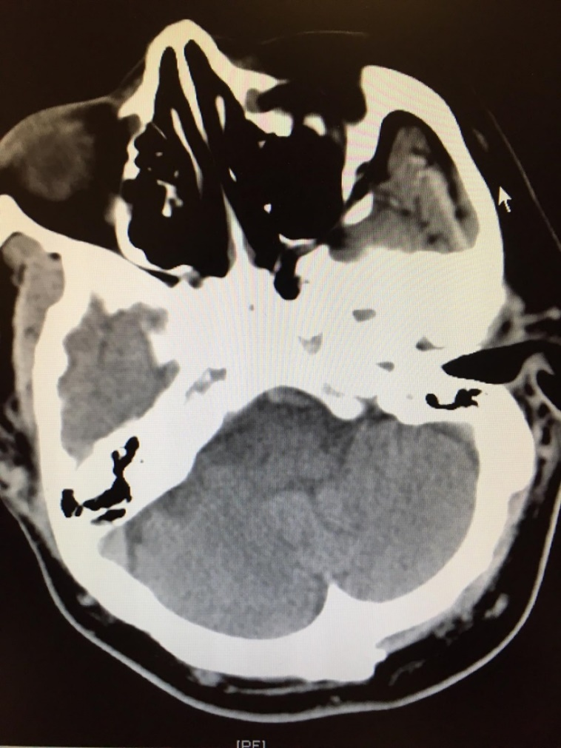
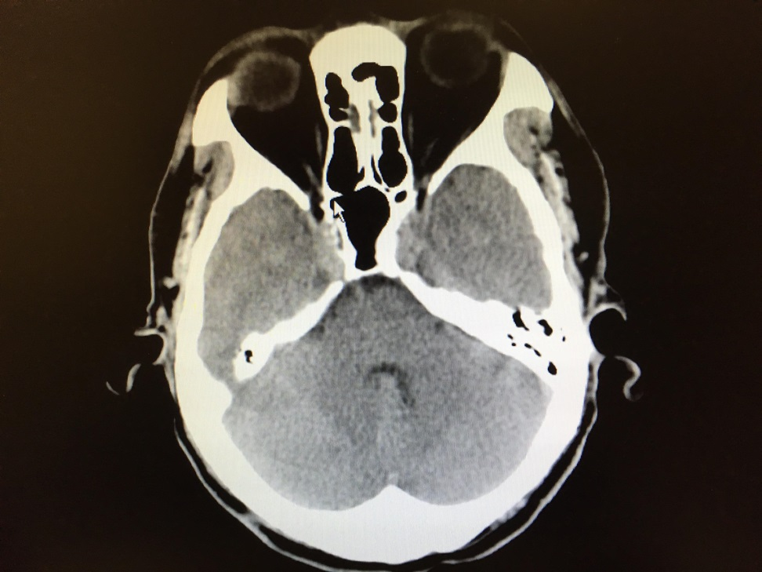
CT brain

Slide 15
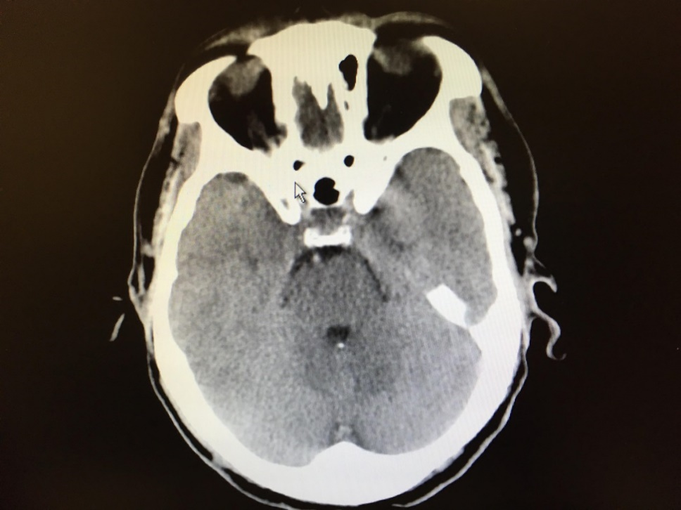
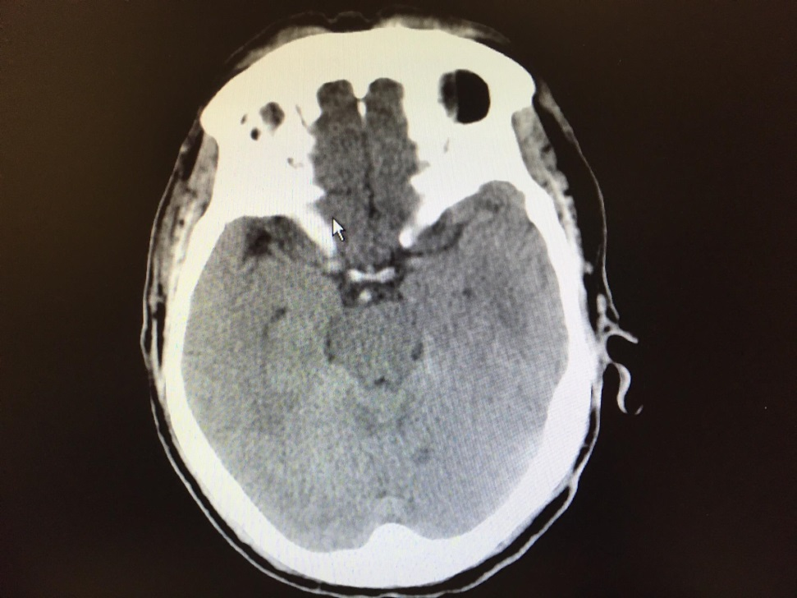
CT brain

Slide 16
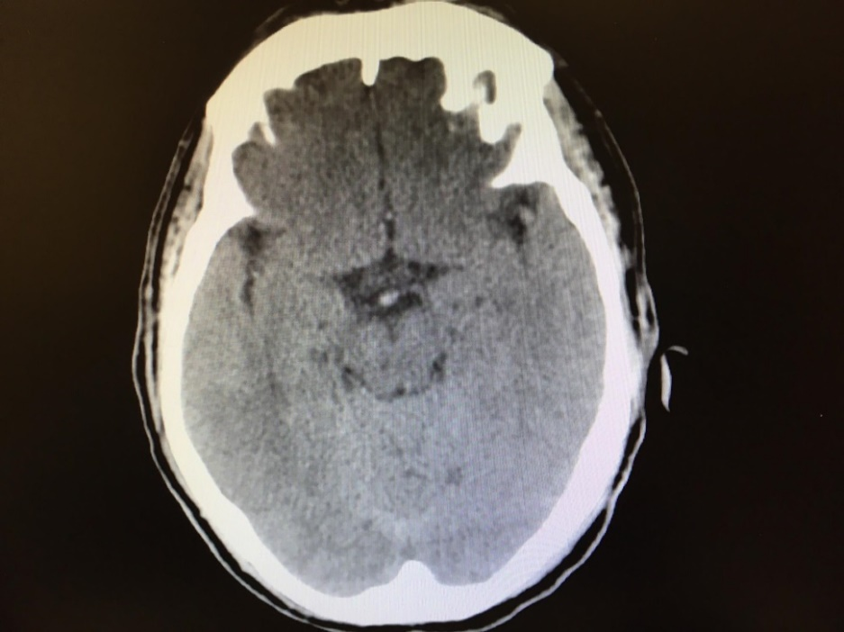
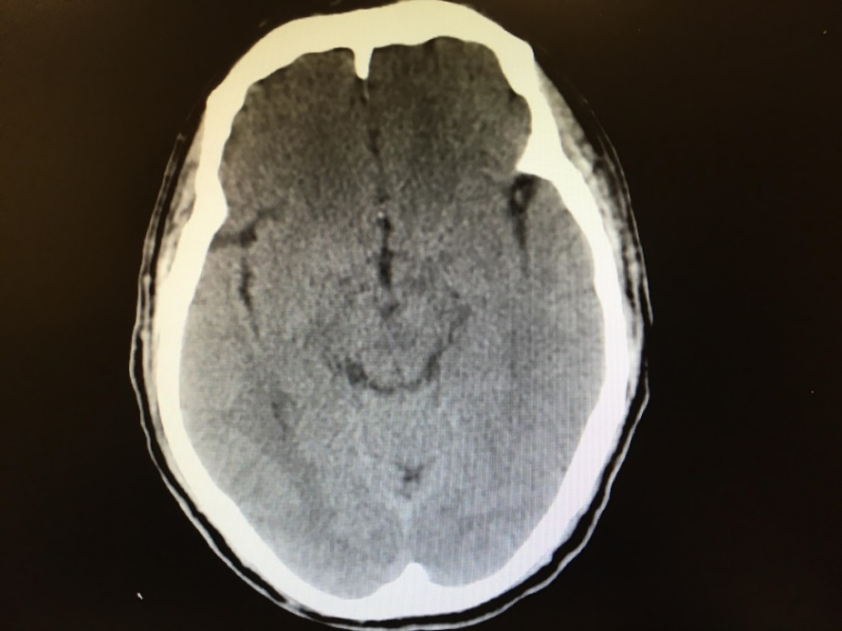
CT brain

Slide 17
Questions
3. Any specific sign in the CT brain?

Slide 18
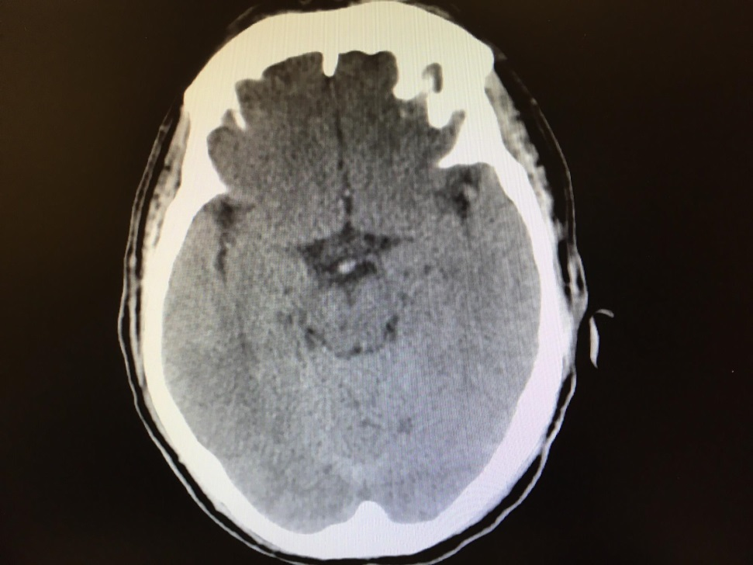
Answers
3. Dense BA sign

Slide 19
Progress
IV TPA given ~ 10:32am, with Rt side power improved to 5-/5
Transfer ASU
1 day later, Rt sided power drop to 0/5, left side power turned to 0-1/5 afterwards, eye movement intact, aphasia +
Repeated CT brain showed no hemorrhage, hypodensities over left paramedian pons

Slide 20
Questions
What is your diagnosis?
Locked-in syndrome

Slide 21
Locked in syndrome
A condition in which a patient is aware but cannot move or communicate verbally due to complete paralysis of nearly all voluntary muscles in the body except for the eyes
Total locked-in syndrome: a version of locked-in syndrome wherein the eyes are paralyzed as well
Caused by damage to specific portions of the lower brain and brainstem, with no damage to upper brain
Features: quadriplegia and the inability to speak in otherwise cognitively intact individuals

Slide 22
Questions - 5
Any other DDX similar to this diagnosis (not in this case)?

Slide 23
Answers - 5
Poisoning – krait bite and other neurotoxic venoms
Amyotrophic lateral sclerosis (MND)
Osmotic demyelination syndrome
Multiple sclerosis

Slide 24
Case 3
A 30 years old gentleman suffered from a fish sting (once) at his right hand. He presented with severe right hand pain and swelling in your AED 30 minutes after the injury. The offending fish and his hand were shown below.

Slide 25
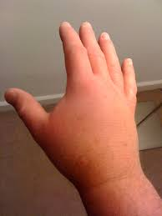
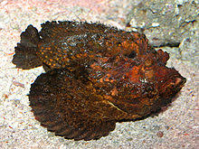
Case 3

Slide 26
Questions
What part of the fish contains the offending poison?

Slide 27
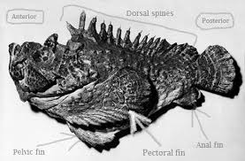
Answer - 1
Dorsal spines

Slide 28
Question - 2
What is the nature of the toxin and what clinical manifestations do you expect?

Slide 29
Answer - 2
Heat labile toxin
May retain full potency for 24-48 hours after death of fish
Antigenic, vasoactive, proteolytic, hemolytic and substances similar to norepinephrine, dopamine, tryptophan
Diffuse effects on circulatory, neurologic, immunologic and respiratory systems
Local effect – immediate severe pain, wound and surrounding tissue necrosis
Systemic effect – GI (vomiting, diarrhea, abdominal pain), CNS (weakness, paraesthesia, delirium, seizures), CVS (hyper/hypotension, tachycardia, arrhythmias), Resp (pulmonary edema, respiratory failure)

Slide 30
Question - 3
What is your treatment strategy?

Slide 31
Answer - 3
Watch out for life threatening systemic effect
Immersion in hot water (43-46 degree Celsus) for 30 minutes
Pain relief
Tetanus prophylaxis
Antibiotic prophylaxis
Surgical wound management
Consider anti-venom

Slide 32
Question - 4
What are the indications for anti-venom?

Slide 33
Answer - 4
Severe systemic effect
Progressive pain despite analgesic

Slide 34
Question - 5
How would you give the anti-venom?

Slide 35
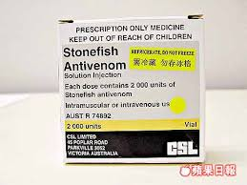
Answer - 5
Dose: 2000U/amp
2000U neutralizes 20mg venom
1 amp for 1-2 punctures
2 amp for 3-4 punctures
3 amp if >4 punctures
IMI (less anaphylactic risk than IV)
Repeat prn
Prepare for anaphylaxis (made from horse serum)

Slide 36
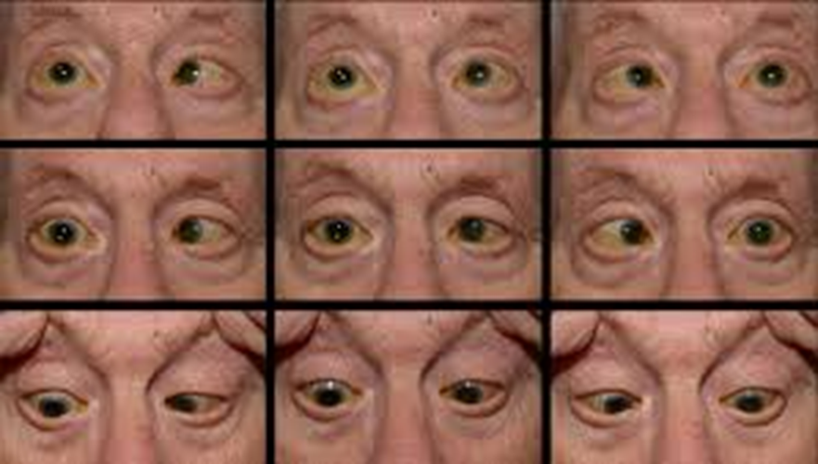
Case 4
M/60, Hx of squamous papilloma of left tongue, c/o: headache for 6 months, diplopia for 1.5 months, exam: GCS 15/15, BP 137/78, no focal neurological sign
Eye exam in following photos

Slide 37
Question - 1
What is the clinical diagnosis?

Slide 38
Answer - 1
Bilateral Abducens nerve palsy

Slide 39
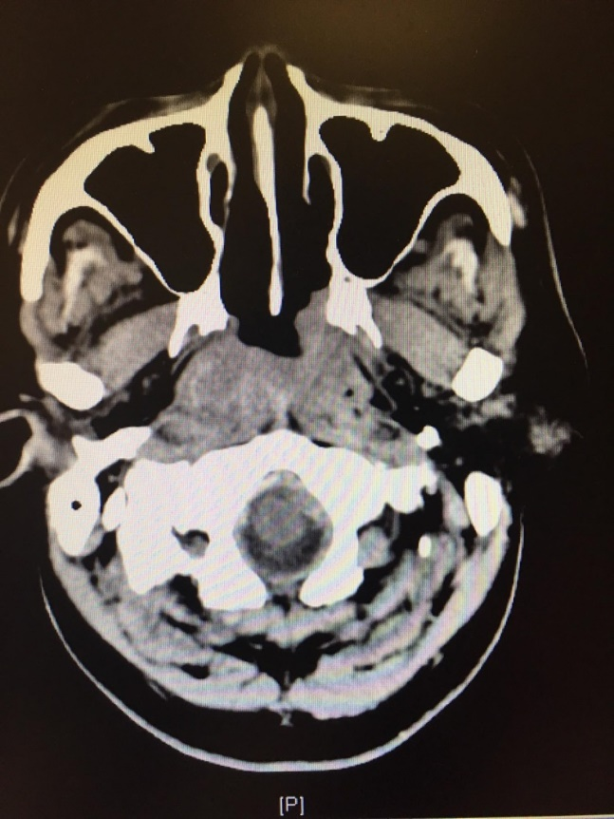
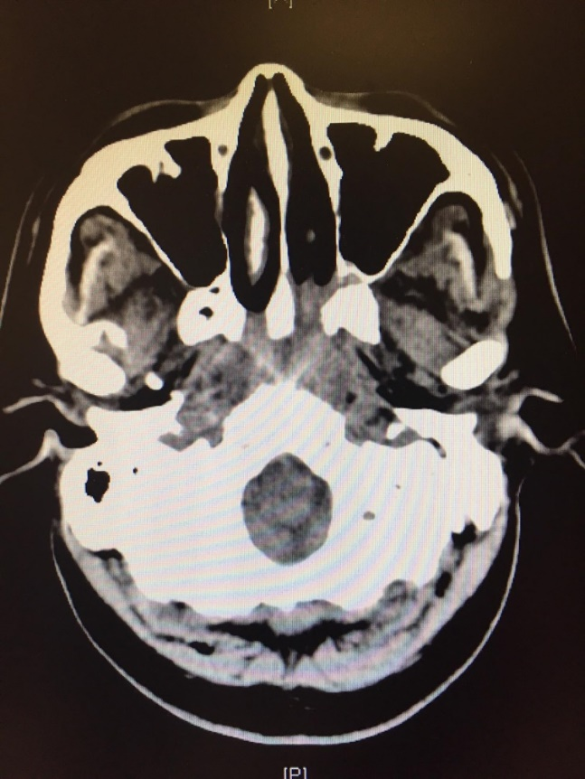
CT brain

Slide 40
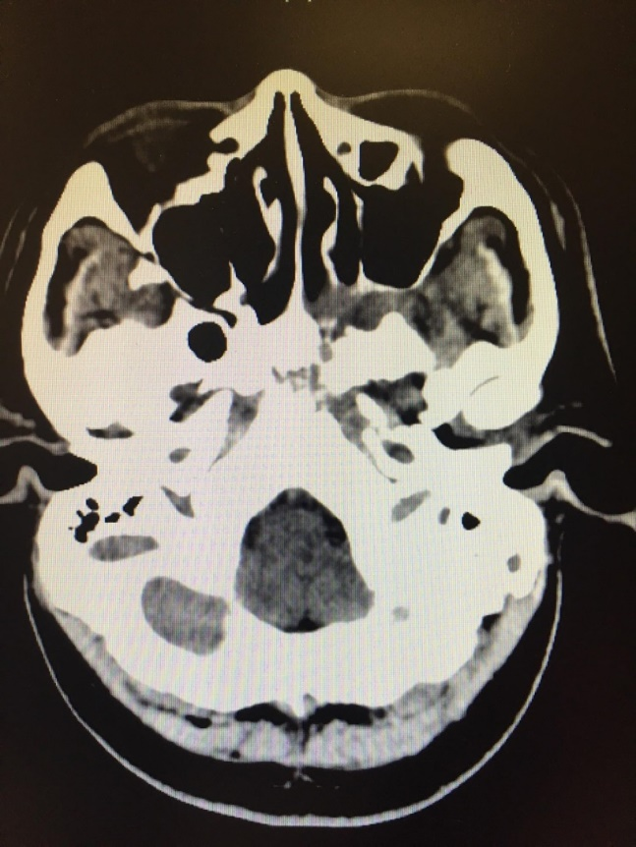
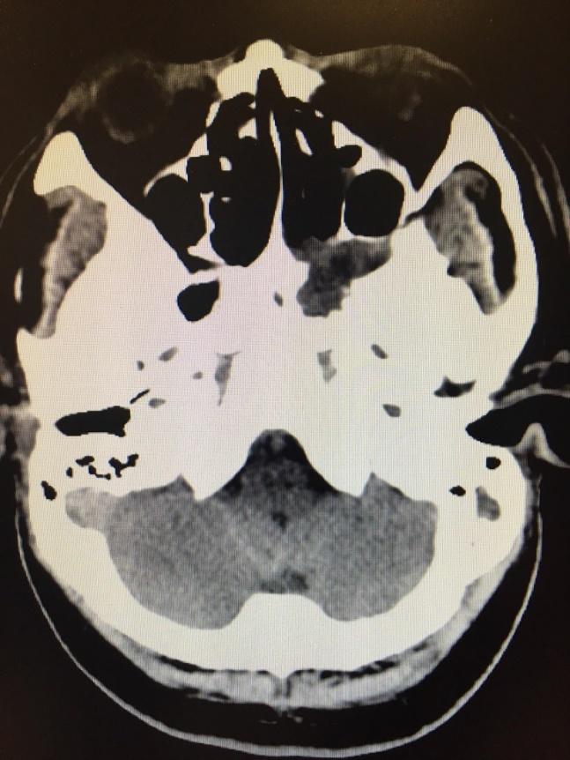
CT brain

Slide 41
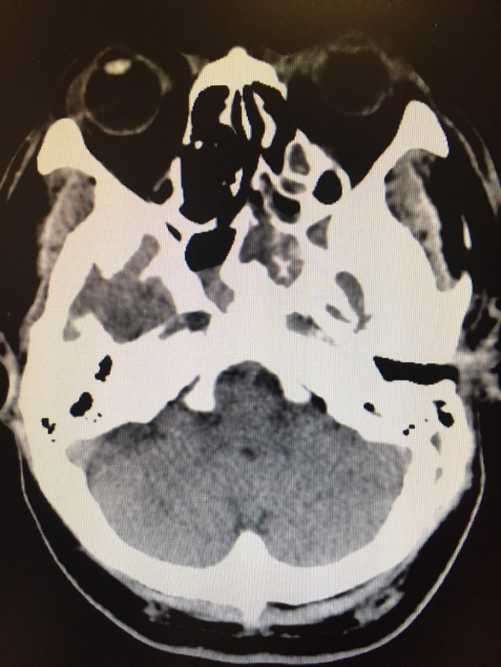
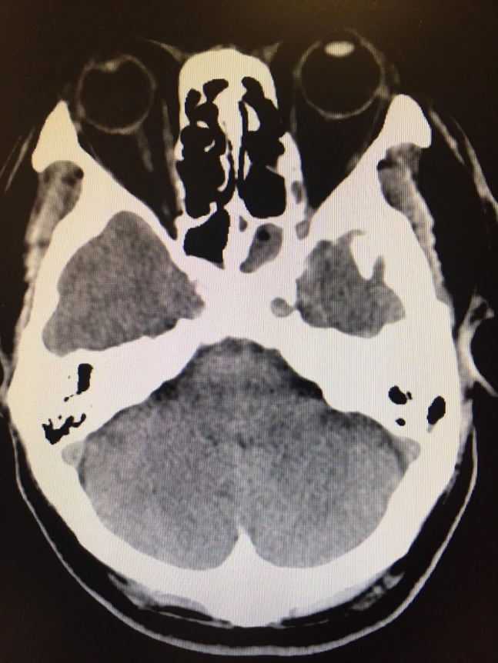
CT brain

Slide 42
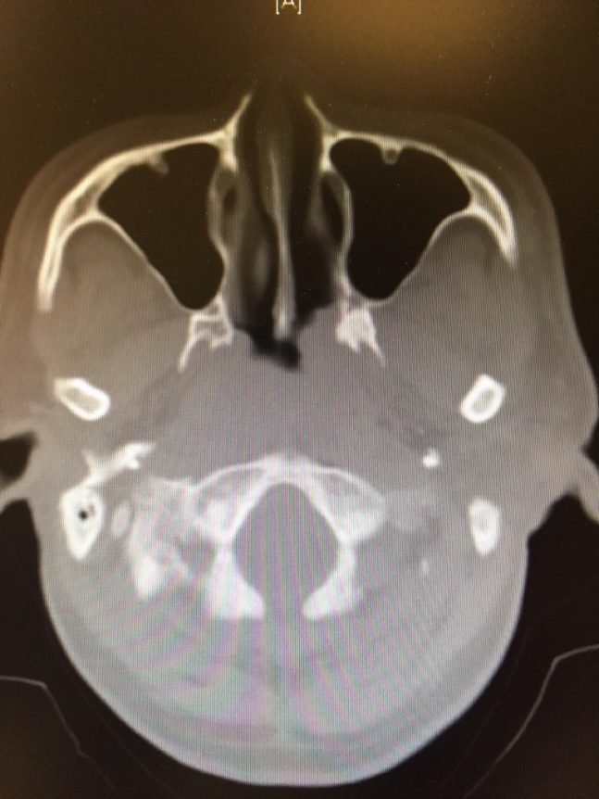
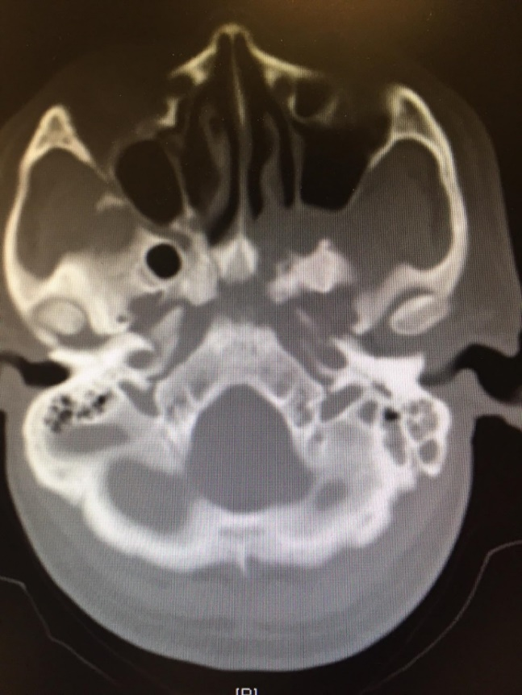
CT bone window

Slide 43
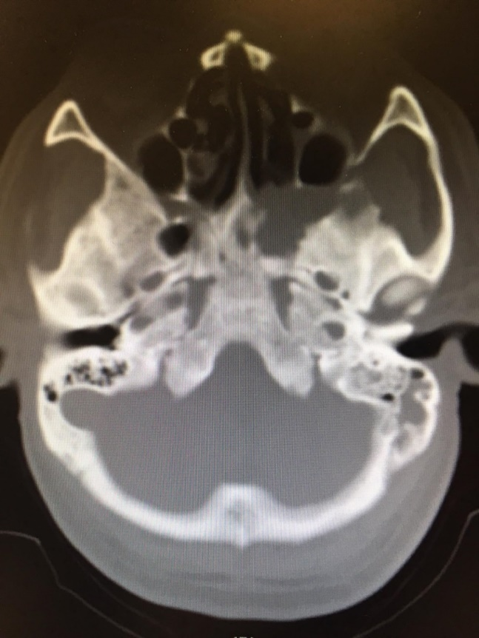
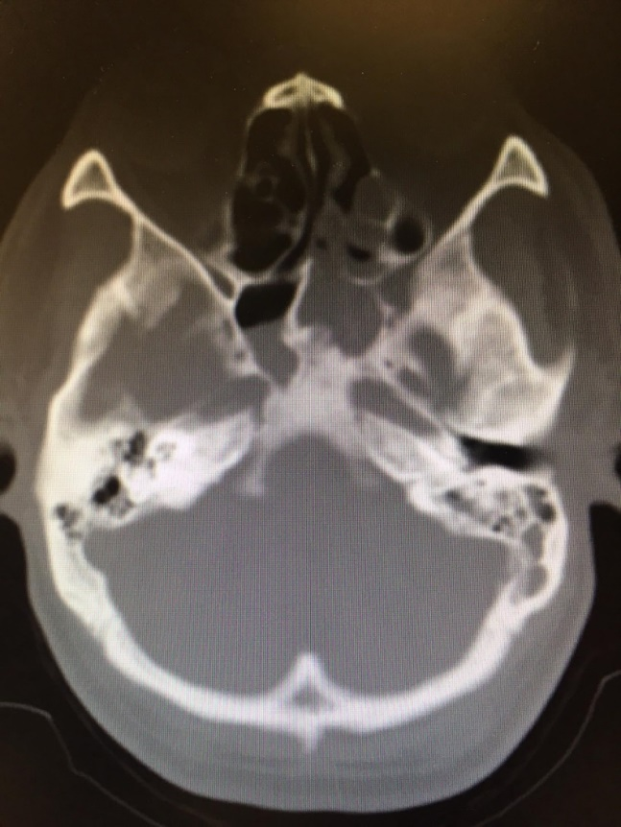
CT bone window

Slide 44
Questions
What are the CT brain abnormalities?

Slide 45
Answers
Asymmetric soft tissue thickening at NP
bony erosion noted at the sphenoid sinus
mucosal thickening and retention changes are noted at bilateral sphenoid and left ethmoid sinuses

Slide 46
Question - 3
What is the most likely diagnosis?

Slide 47
Answer - 3
Suspected nasopharyngeal carcinoma with cavernous sinus thrombosis

Slide 48
Question - 4
What investigations will you order?

Slide 49
Answer - 4
Blood: EBV serology
Radiological: CT brain with contrast/venogram, MRI brain with contrast

Slide 50
ENd

